Slide 1
Concurrency
&
Parallelism
BY: Guillermo De Mendoza

Slide 2
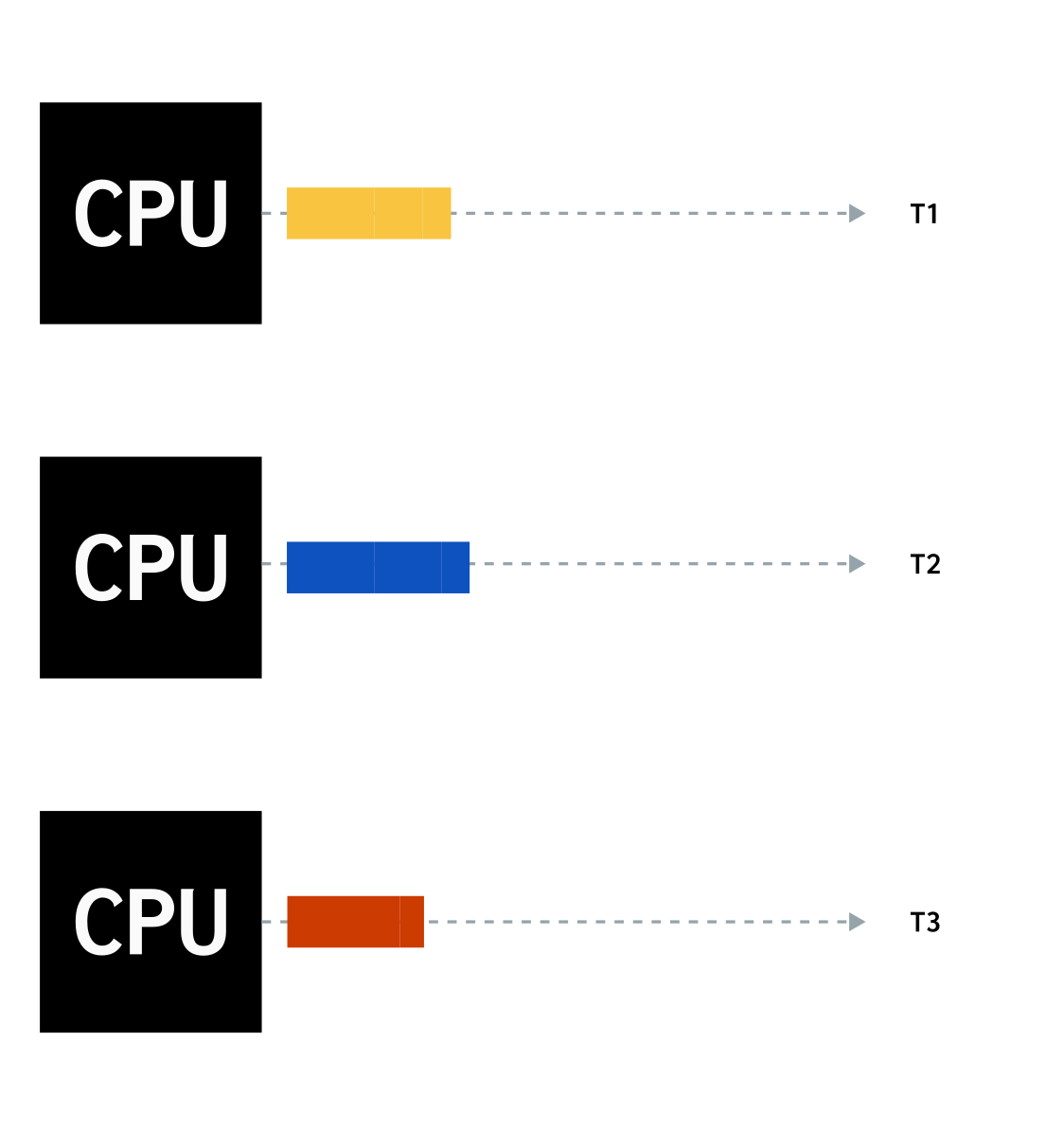
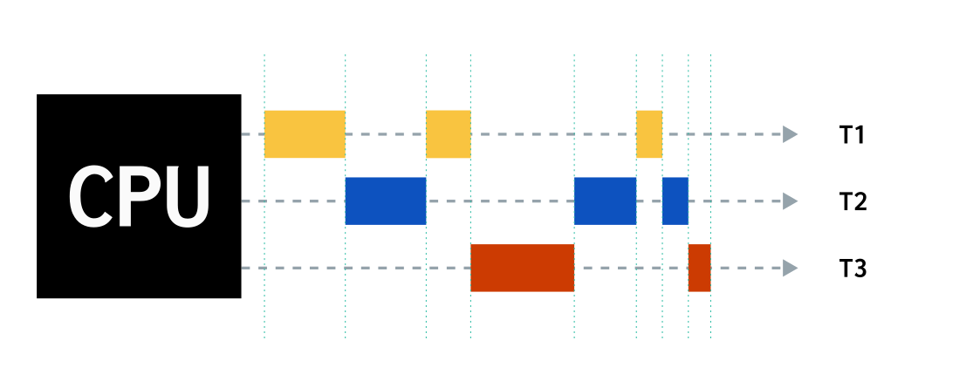
Concurrency
Parallelism
Many task on the same time, but not simultaneously. The CPU alternates between different process
Many task executing at the same time in multiple computing units (cores, cluster)

Slide 3
Threads
The smallest sequence of programmed instructions that can be managed independently by a computing core
A
D
A
B
C
D
B
C
Single thread

Slide 4
Michael Flynn 1972; Architecture classification
SISD
instructions: 1
data: 1
SINGLE CPU
1x2=2
SIMD
instructions: 1
data: many
VECTOR PROCESSING
[1,2,3,4]x2 = [2,4,6,8]
MISD
instructions: many
data: 1
PIPELINE COMPUTER
Redundancy systems, multiples algorithms evaluate same data
MIMD
instructions: many
data: many
MULTICOMPUTERS PIPELINE
Every processor execute its own set of instructions

Slide 5
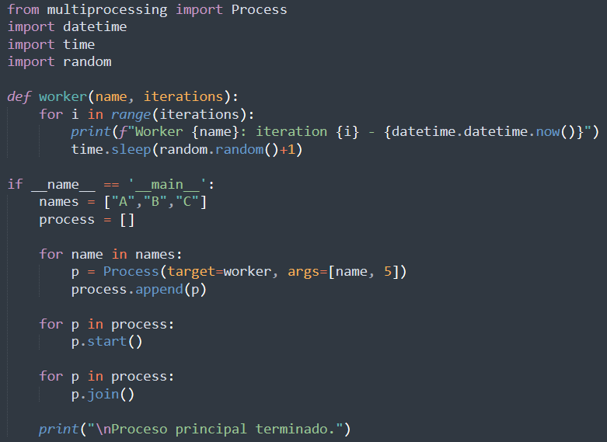
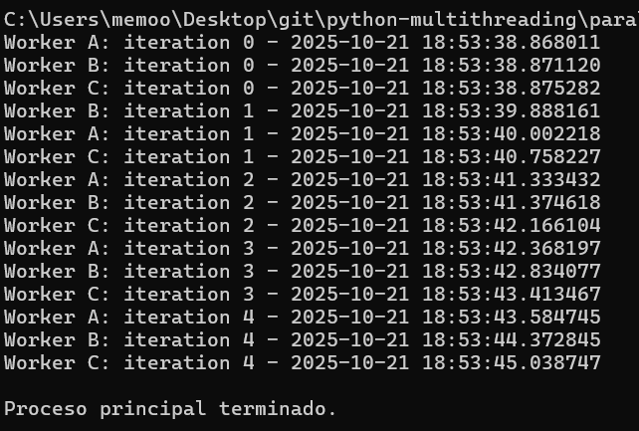
parallel executions in python
Process dont return a value by default

Slide 6
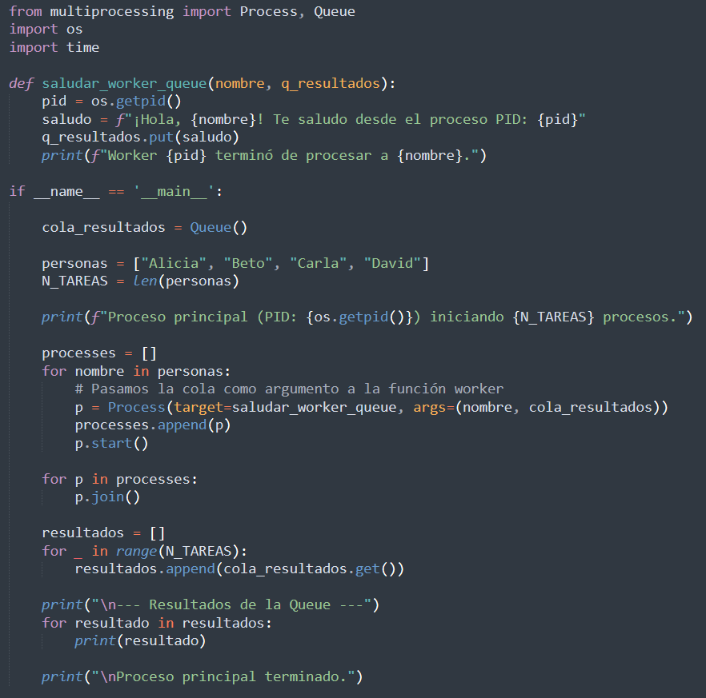
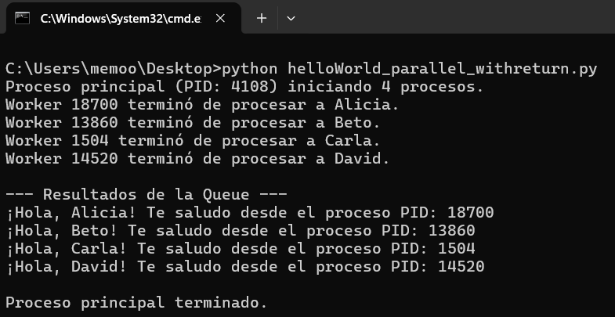
parallel executions in python with return value
The values are collected by a collection (Queue)

Slide 7

Dont use threading !
Python (CPython, which is the standard implementation) does not run multiple CPU threads simultaneously within the same process.
The GIL ensures that only one Python thread runs at a time, even if you have multiple threads created.
Threads in Python do not run in parallel during CPU-bound operations (like your loops that calculate grayscale).
Only one thread can use the CPU at a time; the others wait for their turn.
import threading
t = threading.Thread(target=METHOD, args=(ARGS))
t.start()

Slide 8
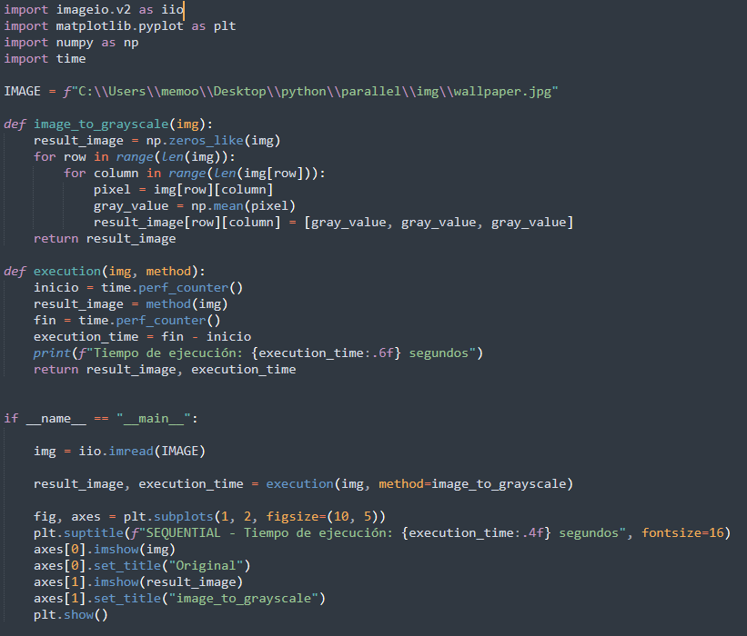
Example
single
core

Slide 9
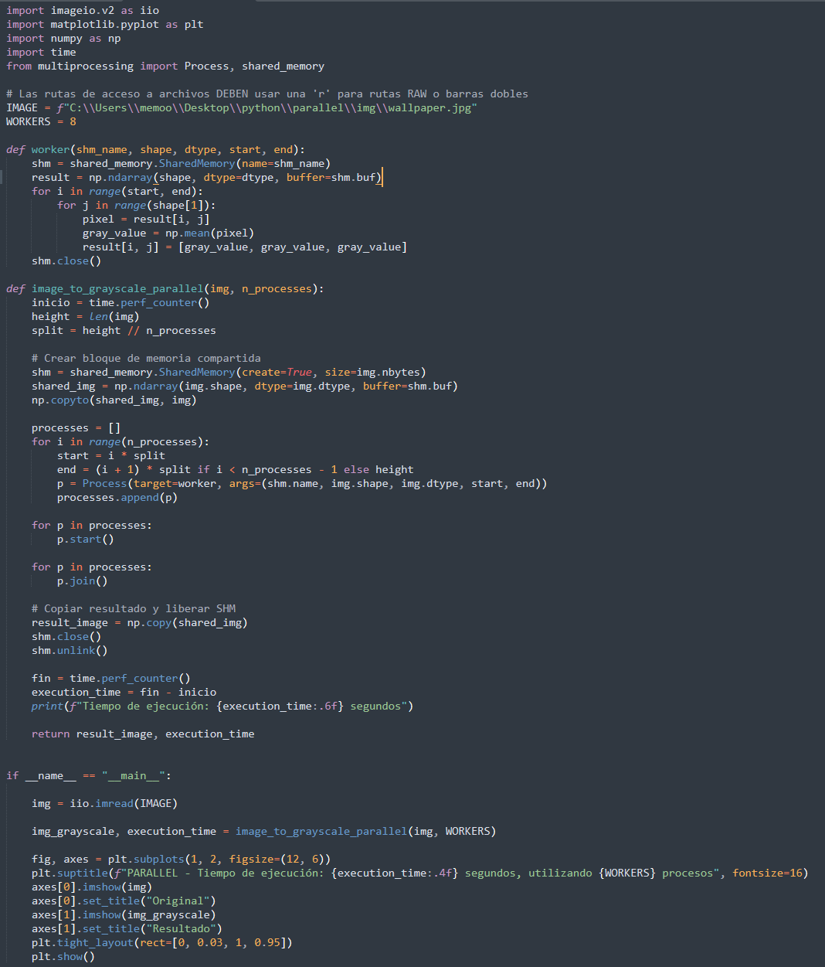
Example
multiple
core

Slide 10
Example
multiple
core
every worker process a range of rows
split the image rows in N process parts
shared image memory
for every process
create workers and assign the row range
recover the image and close the shared memory

Slide 11
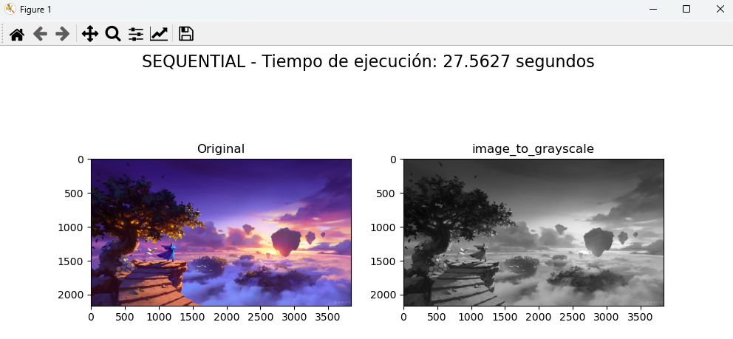
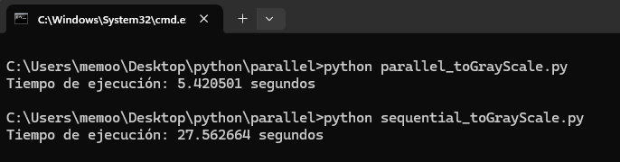
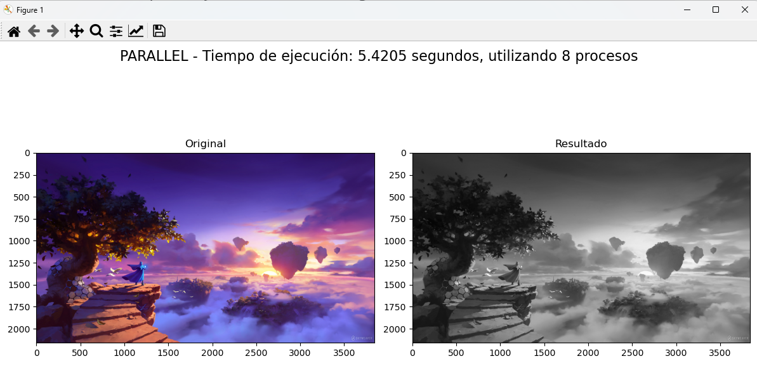
Results

Slide 12
workshop
Traveling Salesman problem

Slide 13
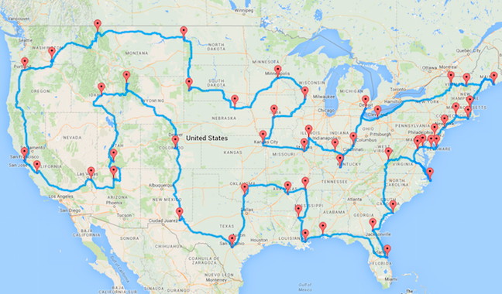
Traveling Salesman problem
The traveling salesman problem (TSP) is a classic optimization problem where the goal is to find the shortest possible route that visits a given set of cities exactly once and then returns to the starting city. It is an NP-hard problem, meaning there is no known efficient algorithm to find the exact solution for all cases, especially as the number of cities grows exponentially. The problem is used to model real-world issues like delivery route planning and logistics.

Slide 14

Traveling Salesman problem
solve by brute force, evaluating every path, compare timing results
Sequential
Parallel

